Slide 1
Digital marketing project
Phase 2
TEAM
Team ID : LTVIP2023TMID1036
team leader : GUMPANA HEMA
GARA POORNA
KALLEPALLI ROHITHA
KOILA HAIMA
KOMATI GEETHANJALI

Slide 2
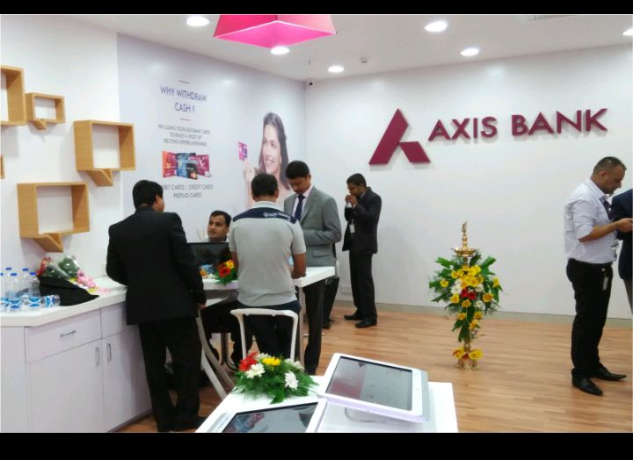
Axis BANK

Slide 3
Part 1: Brand study, Competitor Analysis & Buyer’s/Audience’s Persona
Research Brand: Axis Bank is the third largest private sector bank in India. The Bank offers the entire spectrum of financial services to customer segments covering Large and Mid-Corporates, MSME, Agriculture and Retail Businesses.
Mission/values: Axis Bank's mission is to be the preferred financial solutions provider excelling in customer delivery through insight, empowered employees and smart use of technology.
USP: The Unique Selling Proposition (USP) of Axis Bank is its commitment to providing a wide range of financial products and services to meet the diverse needs of its customers

Slide 4
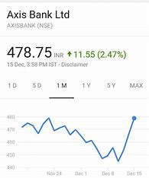
Analyze brand tone and Identity: Endeavour is to add value to our consumers and thereby forge deep rooted connections with them.
Set 5 smart goals and KIPs for the same: KPIs are NOT the same as goals. The goal is the outcome you hope to achieve; the KPI is a metric to let you know how well you're doing working towards that goal. Metrics shouldn't become targets.

Slide 5
Part 1: Brand study, Competitor Analysis & Buyer’s/Audience’s Persona
Buyer’s/Audience’s persona :A buyer persona—also called a user persona, marketing persona, or audience persona—is a fictional profile of your ideal customer based on market and audience research. In other words, it's an imaginary person that embodies the most important characteristics found within your broad audience.

Slide 6
Part 1: Brand study, Competitor Analysis & Buyer’s/Audience’s Persona
Competitor analysis : Who are the top competitors of Axis Bank? The top competitors of Axis Bank include HDFC Bank, IndusInd Bank, Bandhan Bank, IDFC First Bank and Federal Bank. Axis Bank has 170 active competitors.
Competitor -1 : HDFC Bank
Competitor -2 : BANDHAN Bank
Competitor -3 : INDUSIND Bank

Slide 7
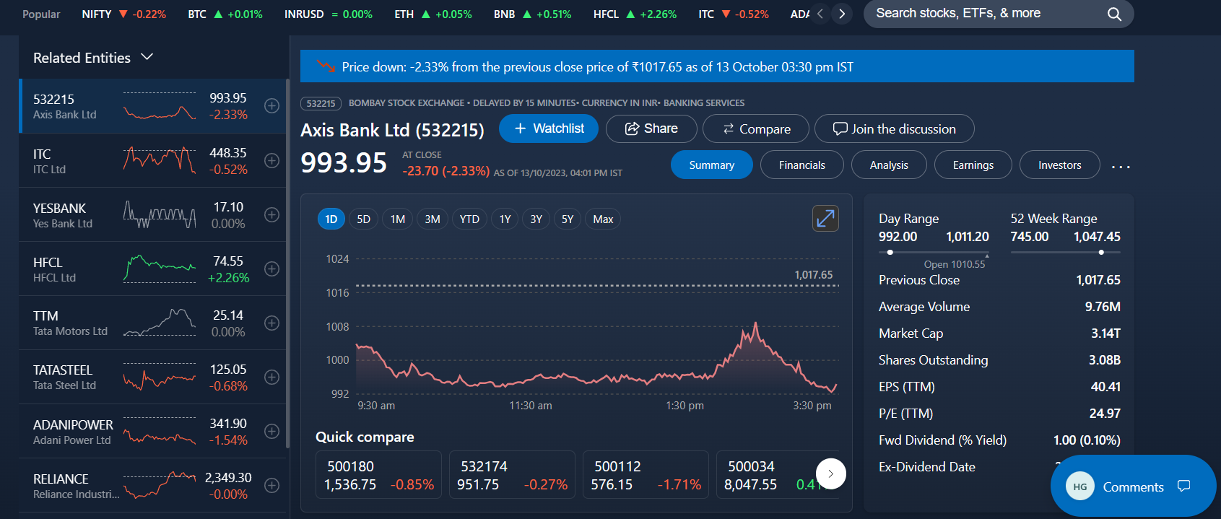
Part 2: SEO & Keyword Research
SEO AUDIT :Since they are focused on Financial and Broking services, we performed the keyword research according to their niche.
Keyword Research : This keyword research report about “axis net banking” will use the data collected by ASOTools for a comprehensive analytic. For example, long tail
ON PAGE OPTIMIZATION: the optimization of axis bank they have used axis bank.com for internet banking .

Slide 8
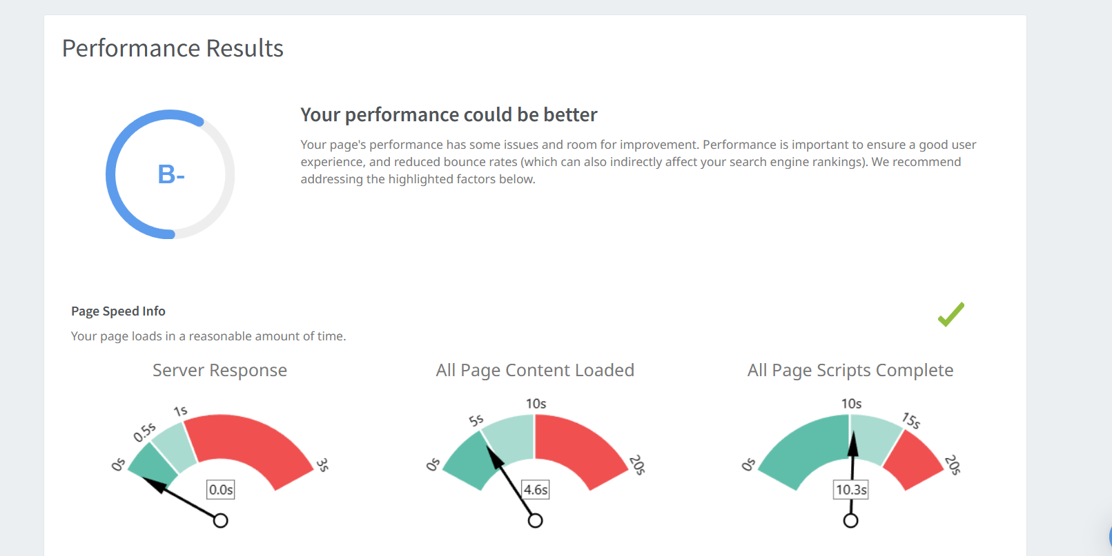
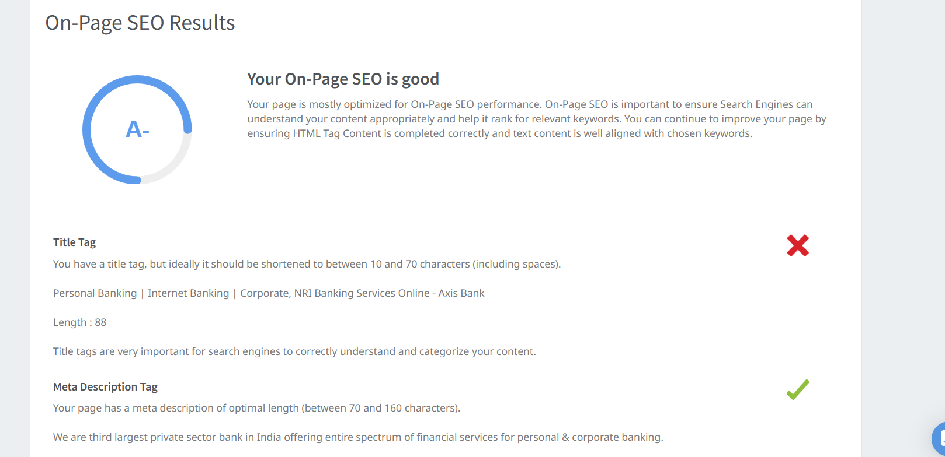
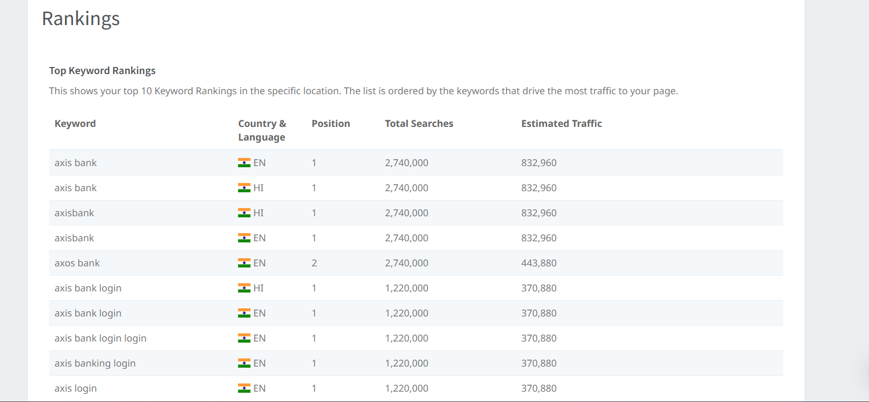
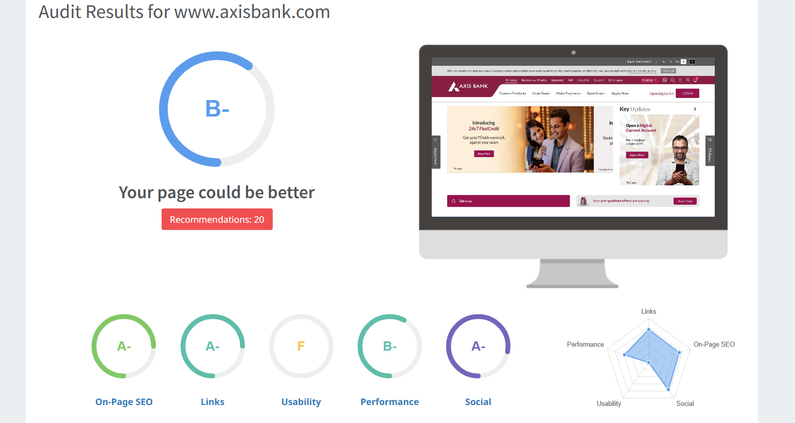
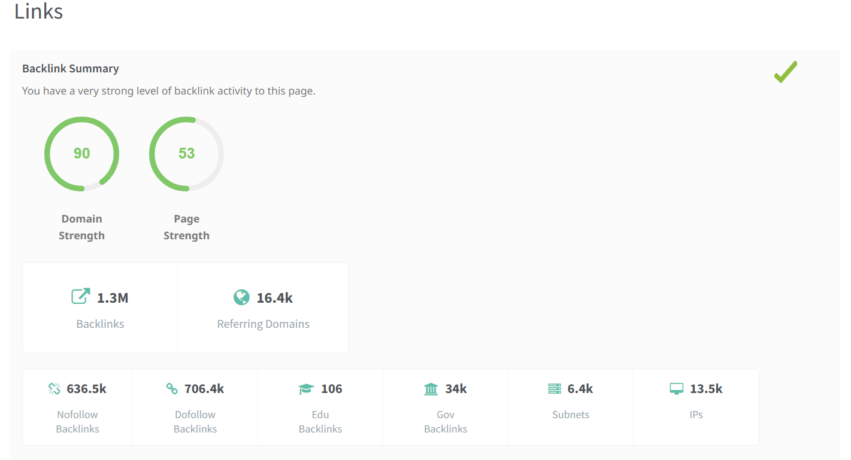
Seo audit for axis bank

Slide 9
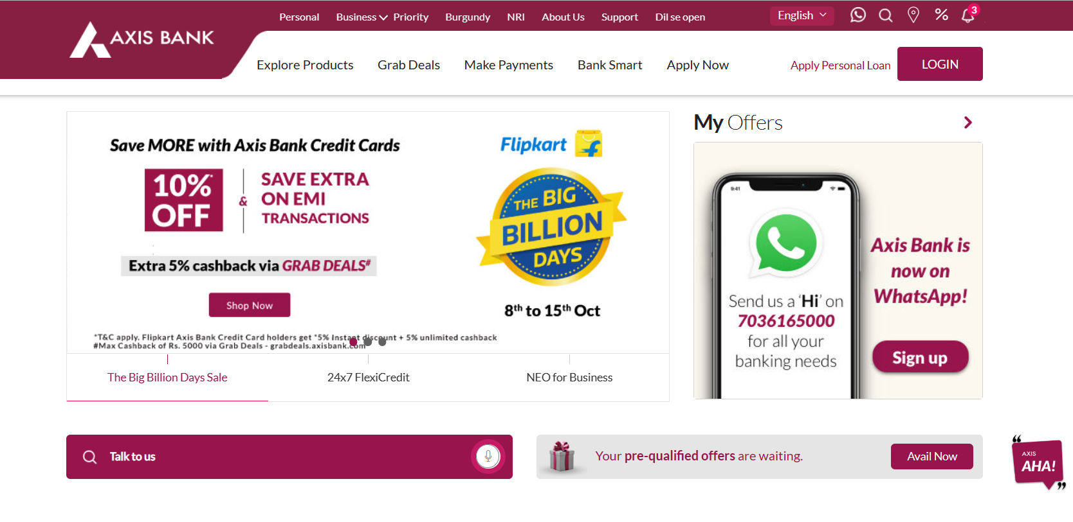
TAGLINE :
Rising Name is a tagline of Axis bank. And these are also tagline for axis bank.
Dil Se Open.
Badhti ka naam zindagi.
Experience Axis.
Digital. Instant. Simple.
Axis Bank. Progress on…
We are just the bank you need.
Everything is the same except the name.
Wherever you are India is the destination for your investments.

Slide 10
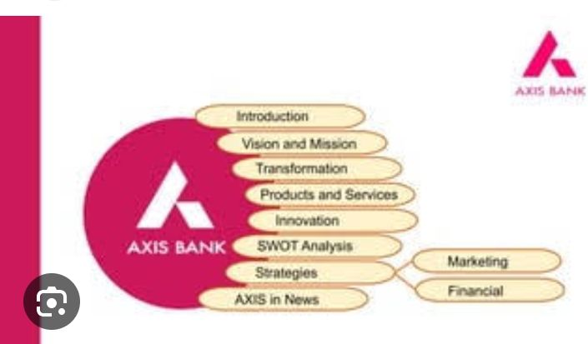
Part 3: Content Ideas and Marketing Strategies
Content Idea Generation and Strategy : Axis Sahyog' is our micro-loan initiative to empower women groups to undertake income generation activities. Women form Joint Liability Groups (JLGs) to access. Three vectors of our strategy for the next three years. 4 rowth rofitability ustainability. •. Grow deposits in line with loans.
Example :

Slide 11
Part 3: Content Ideas and Marketing Strategies
01-Apr-2022 — Axis Bank segments its market according to psychographics and demographic factors like income and occupation and age, social status, etc. Axis Bank had conducted an online gamified competition among B-School students to generate ideas for their Smart Cities campaign

Slide 12

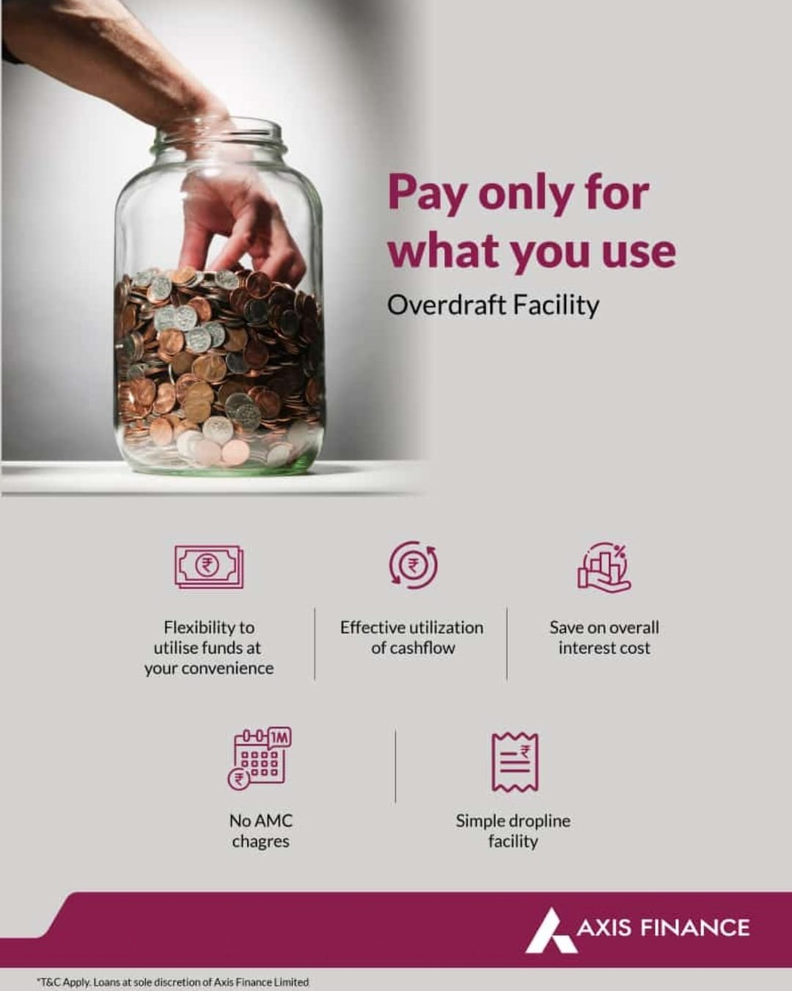
Part 4: Content Creation and Curation
Post Creation : the post creation is to create the post relevant to the axis bank so create some of posts relevant to the axis bank.
Format 1: the first format is to tell about the collebration brtween two campanies or to officially announce the decisions of their owns.
Format 2 : the 2nd content is to know about the they want to know what they are doing in process of new investments.

Slide 13
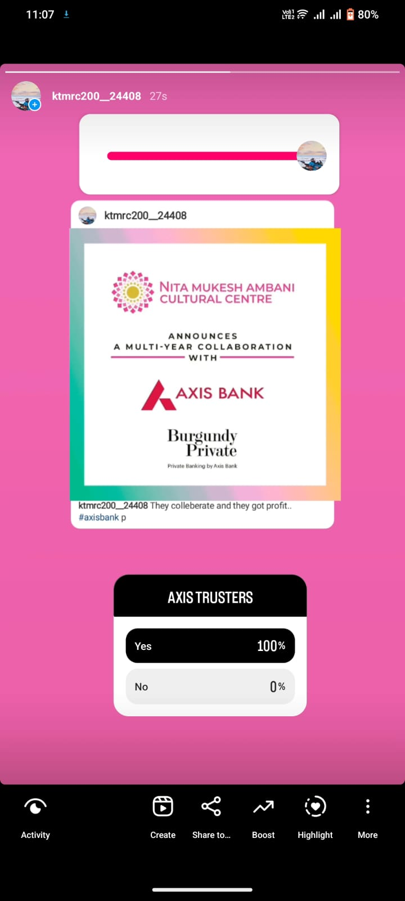
Instagram Story : Instagram story is knowing about the the axis bank and nita ambani are collebratating each other so they can tell about the business announcement.
URL of insta id : https://instagram.com/ktmrc200__24408?igshid=ZGUzMzM3NWJiOQ==

Slide 14
Designs/Video Editing
Vedio editing : in this we use the capcut app and vpn power to use the attributes of cap cut and use the pics art app for photo editing.
thank you

